Slide 1
Lecture week 2: Dictionaries and tolerant retrieval

Slide 2
Word Cloud
http://www.wordle.net/
http://tagcrowd.com/
http://www.edudemic.com/9-word-cloud-generators-that-arent-wordle/

Slide 3
This lecture
Ch. 3
Dictionary data structures
“Tolerant” retrieval
Wild-card queries
Spelling correction
Soundex

Slide 4
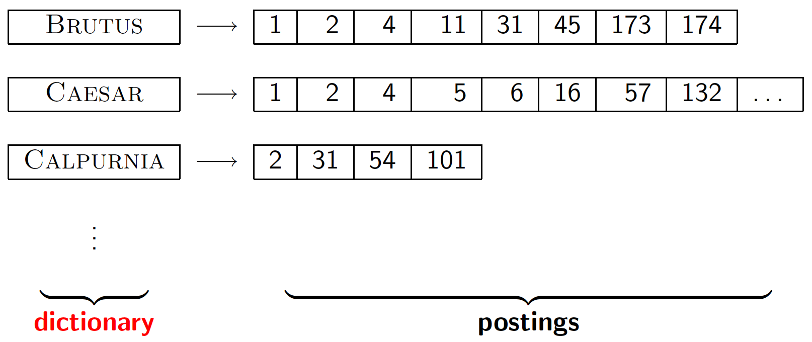
Dictionary data structures for inverted indexes
Sec. 3.1
The dictionary data structure stores the term vocabulary, document frequency, pointers to each postings list … in what data structure?

Slide 5
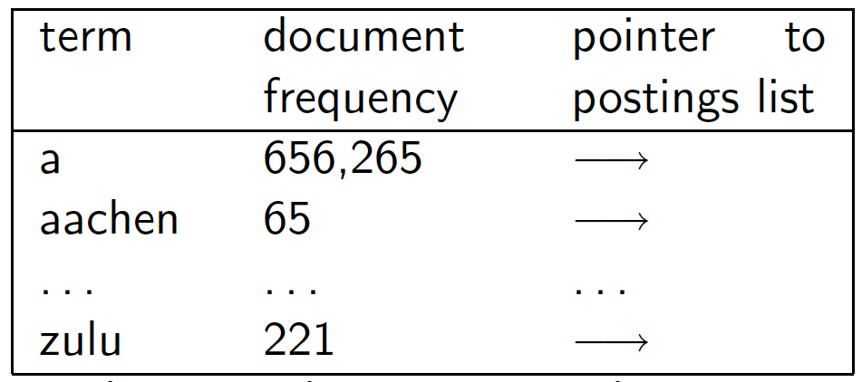
A naïve dictionary
Sec. 3.1
An array of struct:
char[20] int Postings *
20 bytes 4/8 bytes 4/8 bytes
How do we store a dictionary in memory efficiently?
How do we quickly look up elements at query time?

Slide 6
Dictionary data structures
Sec. 3.1
Two main choices:
Hashtables
Trees
Some IR systems use hashtables, some trees

Slide 7
Hashtables
Sec. 3.1
Each vocabulary term is hashed to an integer
(We assume you’ve seen hashtables before)
Pros:
Lookup is faster than for a tree: O(1)
Cons:
No easy way to find minor variants:
judgment/judgement
No prefix search [tolerant retrieval]
If vocabulary keeps growing, need to occasionally do the expensive operation of rehashing everything

Slide 8
Tree: binary tree
Sec. 3.1
Root
a-m
n-z
a-hu
hy-m
n-sh
si-z
huygens
sickle
zygot
aardvark

Slide 9
Tree: B-tree
Sec. 3.1
a-hu
n-z
hy-m
Definition: Every internal nodel has a number of children in the interval [a,b] where a, b are appropriate natural numbers, e.g., [2,4].

Slide 10
Trees
Sec. 3.1
Simplest: binary tree
More usual: B-trees
Trees require a standard ordering of characters and hence strings … but we typically have one
Pros:
Solves the prefix problem (terms starting with hyp)
Cons:
Slower: O(log M) [and this requires balanced tree]
Rebalancing binary trees is expensive
But B-trees mitigate the rebalancing problem

Slide 11
Wild-card queries

Slide 12
Wild-card queries: *
Sec. 3.2
mon*: find all docs containing any word beginning with “mon”.
Easy with binary tree (or B-tree) lexicon: retrieve all words in range: mon ≤ w < moo
*mon: find words ending in “mon”: harder
Maintain an additional B-tree for terms backwards.
Can retrieve all words in range: nom ≤ w < non.
Exercise: from this, how can we enumerate all terms
meeting the wild-card query pro*cent ?

Slide 13
Query processing
Sec. 3.2
At this point, we have an enumeration of all terms in the dictionary that match the wild-card query.
We still have to look up the postings for each enumerated term.
E.g., consider the query:
se*ate AND fil*er
This may result in the execution of many Boolean AND queries.

Slide 14
B-trees handle *’s at the end of a query term
Sec. 3.2
How can we handle *’s in the middle of query term?
co*tion
We could look up co* AND *tion in a B-tree and intersect the two term sets
Expensive
The solution: transform wild-card queries so that the *’s occur at the end
This gives rise to the Permuterm Index.

Slide 15
Permuterm index
Sec. 3.2.1
For term hello, index under:
hello$, ello$h, llo$he, lo$hel, o$hell, $hello
where $ is a special symbol.

Slide 16
Permuterm query processing
Sec. 3.2.1
Rotate query wild-card to the right
Now use B-tree lookup as before.
Permuterm problem: ≈ quadruples lexicon size
Empirical observation for English.

Slide 17
Bigram (k-gram) indexes
Sec. 3.2.2
Enumerate all k-grams (sequence of k chars) occurring in any term
e.g., from text “April is the cruelest month” we get the 2-grams (bigrams)
$ is a special word boundary symbol
Maintain a second inverted index from bigrams to dictionary terms that match each bigram.
$a,ap,pr,ri,il,l$,$i,is,s$,$t,th,he,e$,$c,cr,ru,
ue,el,le,es,st,t$, $m,mo,on,nt,h$

Slide 18
Bigram index example
Sec. 3.2.2
The k-gram index finds terms based on a query consisting of k-grams (here k=2).
$m
mace
madden
mo
among
amortize
on
along
among

Slide 19
Processing wild-cards
Sec. 3.2.2
Query mon* can now be run as
$m AND mo AND on
Gets terms that match AND version of our wildcard query.
But we’d enumerate moon.
Must post-filter these terms against query.
Surviving enumerated terms are then looked up in the term-document inverted index.
Fast, space efficient (compared to permuterm).

Slide 20
Spelling correction

Slide 21
Spell correction
Sec. 3.3
Two principal uses
Correcting document(s) being indexed
Correcting user queries to retrieve “right” answers
Two main flavors:
Isolated word
Check each word on its own for misspelling
Will not catch typos resulting in correctly spelled words
e.g., from → form
Context-sensitive
Look at surrounding words,
e.g., I flew form Heathrow to Narita.

Slide 22
Document correction
Sec. 3.3
Especially needed for OCR’ed documents
Correction algorithms are tuned for this: rn/m
Can use domain-specific knowledge
E.g., OCR can confuse O and D more often than it would confuse O and I (adjacent on the QWERTY keyboard, so more likely interchanged in typing).
But also: web pages and even printed material have typos
Goal: the dictionary contains fewer misspellings
But often we don’t change the documents and instead fix the query-document mapping

Slide 23
Query mis-spellings
Sec. 3.3
Our principal focus here
E.g., the query Alanis Morisett
We can either
Retrieve documents indexed by the correct spelling, OR
Return several suggested alternative queries with the correct spelling
Did you mean … ?

Slide 24
Isolated word correction
Sec. 3.3.2
Fundamental premise – there is a lexicon from which the correct spellings come
Two basic choices for this
A standard lexicon such as
Webster’s English Dictionary
An “industry-specific” lexicon – hand-maintained
The lexicon of the indexed corpus
E.g., all words on the web
All names, acronyms etc.
(Including the mis-spellings)

Slide 25
Isolated word correction
Sec. 3.3.2
Given a lexicon and a character sequence Q, return the words in the lexicon closest to Q
What’s “closest”?
We’ll study several alternatives
Edit distance (Levenshtein distance)
Weighted edit distance
n-gram overlap

Slide 26
Edit distance
Sec. 3.3.3
Given two strings S₁ and S₂, the minimum number of operations to convert one to the other
Operations are typically character-level
Insert, Delete, Replace, (Transposition)
E.g., the edit distance from dof to dog is 1
From cat to act is 2 (Just 1 with transpose.)
from cat to dog is 3.
Generally found by dynamic programming.
See http://www.merriampark.com/ld.htm for a nice example plus an applet.

Slide 27
Weighted edit distance
Sec. 3.3.3
As above, but the weight of an operation depends on the character(s) involved
Meant to capture OCR or keyboard errors Example: m more likely to be mis-typed as n than as q
Therefore, replacing m by n is a smaller edit distance than by q
This may be formulated as a probability model
Requires weight matrix as input
Modify dynamic programming to handle weights

Slide 28
Using edit distances
Sec. 3.3.4
Given query, first enumerate all character sequences within a preset (weighted) edit distance (e.g., 2)
Intersect this set with list of “correct” words
Show terms you found to user as suggestions
Alternatively,
We can look up all possible corrections in our inverted index and return all docs … slow
We can run with a single most likely correction
The alternatives disempower the user, but save a round of interaction with the user

Slide 29
Edit distance to all dictionary terms?
Sec. 3.3.4
Given a (mis-spelled) query – do we compute its edit distance to every dictionary term?
Expensive and slow
Alternative?
How do we cut the set of candidate dictionary terms?
One possibility is to use n-gram overlap for this
This can also be used by itself for spelling correction.
Notes:
Alternative is to generate everything up to edit distance k and then intersect. Fine for distance 1; okay for distance 2. This is generally enough (Norvig).

Slide 30
n-gram overlap
Sec. 3.3.4
Enumerate all the n-grams in the query string as well as in the lexicon
Use the n-gram index (recall wild-card search) to retrieve all lexicon terms matching any of the query n-grams
Threshold by number of matching n-grams
Variants – weight by keyboard layout, etc.

Slide 31
Example with trigrams
Sec. 3.3.4
Suppose the text is november
Trigrams are nov, ove, vem, emb, mbe, ber.
The query is december
Trigrams are dec, ece, cem, emb, mbe, ber.
So 3 trigrams overlap (of 6 in each term)
How can we turn this into a normalized measure of overlap?

Slide 32
One option – Jaccard coefficient
Sec. 3.3.4
A commonly-used measure of overlap
Let X and Y be two sets; then the J.C. is
Equals 1 when X and Y have the same elements and zero when they are disjoint
X and Y don’t have to be of the same size
Always assigns a number between 0 and 1
Now threshold to decide if you have a match
E.g., if J.C. > 0.8, declare a match

Slide 33
Matching trigrams
Sec. 3.3.4
Consider the query lord – we wish to identify words matching 2 of its 3 bigrams (lo, or, rd)
lo
alone
lore
sloth
or
border
lore
morbid
rd
ardent
border
card
Standard postings “merge” will enumerate …
Adapt this to using Jaccard (or another) measure.

Slide 34
Context-sensitive spell correction
Sec. 3.3.5
Text: I flew from Heathrow to Narita.
Consider the phrase query “flew form Heathrow”
We’d like to respond
Did you mean “flew from Heathrow”?
because no docs matched the query phrase.

Slide 35
Context-sensitive correction
Sec. 3.3.5
Need surrounding context to catch this.
First idea: retrieve dictionary terms close (in weighted edit distance) to each query term
Now try all possible resulting phrases with one word “fixed” at a time
flew from heathrow
fled form heathrow
flea form heathrow
Hit-based spelling correction: Suggest the alternative that has lots of hits.

Slide 36
Exercise
Sec. 3.3.5
Suppose that for “flew form Heathrow” we have 7 alternatives for flew, 19 for form and 3 for heathrow.
How many “corrected” phrases will we enumerate in this scheme?

Slide 37
Another approach
Sec. 3.3.5
Break phrase query into a conjunction of biwords.
Look for biwords that need only one term corrected.
Enumerate only phrases containing “common” biwords.

Slide 38
General issues in spell correction
Sec. 3.3.5
We enumerate multiple alternatives for “Did you mean?”
Need to figure out which to present to the user
The alternative hitting most docs
Query log analysis
More generally, rank alternatives probabilistically
argmax_{corr} P(corr | query)
From Bayes rule, this is equivalent to argmax_{corr} P(query | corr) * P(corr)
Noisy channel
Language model

Slide 39
Soundex

Slide 40
Soundex
Sec. 3.4
Class of heuristics to expand a query into phonetic equivalents
Language specific – mainly for names
E.g., chebyshev → tchebycheff
Invented for the U.S. census … in 1918

Slide 41
Soundex – typical algorithm
Sec. 3.4
Turn every token to be indexed into a 4-character reduced form
Do the same with query terms
Build and search an index on the reduced forms
(when the query calls for a soundex match)
http://www.creativyst.com/Doc/Articles/SoundEx1/SoundEx1.htm#Top

Slide 42
Soundex – typical algorithm
Sec. 3.4
Retain the first letter of the word.
Change all occurrences of the following letters to '0' (zero): 'A', E', 'I', 'O', 'U', 'H', 'W', 'Y'.
Change letters to digits as follows:
B, F, P, V → 1
C, G, J, K, Q, S, X, Z → 2
D,T → 3
L → 4
M, N → 5
R → 6

Slide 43
Soundex continued
Sec. 3.4
Remove all pairs of consecutive digits.
Remove all zeros from the resulting string.
Pad the resulting string with trailing zeros and return the first four positions, which will be of the form <uppercase letter> <digit> <digit> <digit>.
E.g., Herman becomes H655.
Will hermann generate the same code?

Slide 44
Soundex
Sec. 3.4
Soundex is the classic algorithm, provided by most databases (Oracle, Microsoft, …)
How useful is soundex?
Not very – for information retrieval
Okay for “high recall” tasks (e.g., Interpol), though biased to names of certain nationalities
Zobel and Dart (1996) show that other algorithms for phonetic matching perform much better in the context of IR

Slide 45
What queries can we process?
We have
Positional inverted index
Wild-card index
Spell-correction
Soundex

Slide 46
Scoring, Term Weighting, and Vector Space Model

Slide 47
Binary incidence matrix
 | Anthony and Cleopatra | Julius Caesar | The Tempest | Hamlet | Othello | Macbeth . . .
ANTHONY BRUTUS CAESAR CALPURNIA CLEOPATRA MERCY WORSER . . . | 1 1 1 0 1 1 1 | 1 1 1 1 0 0 0 | 0 0 0 0 0 1 1 | 0 1 1 0 0 1 1 | 0 0 1 0 0 1 1 | 1 0 1 0 0 1 0
Each document is represented as a binary vector ∈ {0, 1}^{|V|.}
47

Slide 48
Binary incidence matrix
 | Anthony and Cleopatra | Julius Caesar | The Tempest | Hamlet | Othello | Macbeth . . .
ANTHONY BRUTUS CAESAR CALPURNIA CLEOPATRA MERCY WORSER . . . | 157 4 232 0 57 2 2 | 73 157 227 10 0 0 0 | 0 0 0 0 0 3 1 | 0 2 2 0 0 8 1 | 0 0 1 0 0 5 1 | 1 0 0 0 0 8 5
Each document is now represented as a count vector ∈ N^{|V|.}
48

Slide 49
Bag of words model
We do not consider the order of words in a document.
John is quicker than Mary and Mary is quicker than John are represented the same way.
This is called a bag of words model.
In a sense, this is a step back: The positional index was able to distinguish these two documents.
We will look at “recovering” positional information later in this course.
For now: bag of words model
49

Slide 50
Term frequency tf
The term frequency tf_{t,d} of term t in document d is defined as the number of times that t occurs in d.
We want to use tf when computing query-document match scores.
But how?
Raw term frequency is not what we want because:
A document with tf = 10 occurrences of the term is more relevant than a document with tf = 1 occurrence of the term.
But not 10 times more relevant.
Relevance does not increase proportionally with term frequency.
50

Slide 51

Instead of raw frequency: Log frequency weighting
The log frequency weight of term t in d is defined as follows
tf_{t,d} → w_{t,d} : 0 → 0, 1 → 1, 2 → 1.3, 10 → 2, 1000 → 4, etc.
Score for a document-query pair: sum over terms t in both q and d: tf-matching-score(q, d) = _{t∈q∩d} (1 + log tf_{t,d} )
The score is 0 if none of the query terms is present in the document.
51

Slide 52
Frequency in document vs. frequency in collection
In addition, to term frequency (the frequency of the term in the document) . . .
. . .we also want to use the frequency of the term in the collection for weighting and ranking.
52

Slide 53
Desired weight for rare terms
Rare terms are more informative than frequent terms.
Consider a term in the query that is rare in the collection (e.g., ARACHNOCENTRIC).
A document containing this term is very likely to be relevant.
→ We want high weights for rare terms like ARACHNOCENTRIC.
53

Slide 54
Desired weight for frequent terms
Frequent terms are less informative than rare terms.
Consider a term in the query that is frequent in the collection (e.g., GOOD, INCREASE, LINE).
A document containing this term is more likely to be relevant than a document that doesn’t . . .
. . . but words like GOOD, INCREASE and LINE are not sure indicators of relevance.
→ For frequent terms like GOOD, INCREASE and LINE, we want positive weights . . .
. . . but lower weights than for rare terms.
54

Slide 55
Document frequency
We want high weights for rare terms like ARACHNOCENTRIC.
We want low (positive) weights for frequent words like GOOD, INCREASE and LINE.
We will use document frequency to factor this into computing the matching score.
The document frequency is the number of documents in the collection that the term occurs in.
55

Slide 56

idf weight
df_{t} is the document frequency, the number of documents that t occurs in.
df_{t} is an inverse measure of the informativeness of term t.
We define the idf weight of term t as follows:
(N is the number of documents in the collection.)
idf_{t} is a measure of the informativeness of the term.
[log N/df_{t} ] instead of [N/df_{t} ] to “dampen” the effect of idf
Note that we use the log transformation for both term frequency and document frequency.
56

Slide 57

Examples for idf
Compute idf_{t} using the formula:
term | df_{t} | idf_{t}
calpurnia animal sunday fly under the | 1 100 1000 10,000 100,000 1,000,000 | 6 4 3 2 1 0
57

Slide 58
Effect of idf on ranking
idf affects the ranking of documents for queries with at least two terms.
For example, in the query “arachnocentric line”, idf weighting increases the relative weight of ARACHNOCENTRIC and decreases the relative weight of LINE.
idf has little effect on ranking for one-term queries.
58

Slide 59
Collection frequency vs. Document frequency
word | collection frequency | document frequency
INSURANCE TRY | 10440 10422 | 3997 8760
Collection frequency of t: number of tokens of t in the collection
Document frequency of t: number of documents t occurs in
Why these numbers?
Which word is a better search term (and should get a higher weight)?
This example suggests that df (and idf) is better for weighting than cf (and “icf”).
59

Slide 60

tf-idf weighting
The tf-idf weight of a term is the product of its tf weight and its idf weight.
tf-weight
idf-weight
Best known weighting scheme in information retrieval
Note: the “-” in tf-idf is a hyphen, not a minus sign!
Alternative names: tf.idf, tf x idf
60

Slide 61

Summary: tf-idf
Assign a tf-idf weight for each term t in each document d:
The tf-idf weight . . .
. . . increases with the number of occurrences within a document. (term frequency)
. . . increases with the rarity of the term in the collection. (inverse document frequency)
61

Slide 62
Outline
Recap
Why ranked retrieval?
Term frequency
tf-idf weighting
The vector space model

Slide 63
Binary incidence matrix
 | Anthony and Cleopatra | Julius Caesar | The Tempest | Hamlet | Othello | Macbeth . . .
ANTHONY BRUTUS CAESAR CALPURNIA CLEOPATRA MERCY WORSER . . . | 1 1 1 0 1 1 1 | 1 1 1 1 0 0 0 | 0 0 0 0 0 1 1 | 0 1 1 0 0 1 1 | 0 0 1 0 0 1 1 | 1 0 1 0 0 1 0
Each document is represented as a binary vector ∈ {0, 1}^{|V|.}
63

Slide 64
Count matrix
 | Anthony and Cleopatra | Julius Caesar | The Tempest | Hamlet | Othello | Macbeth . . .
ANTHONY BRUTUS CAESAR CALPURNIA CLEOPATRA MERCY WORSER . . . | 157 4 232 0 57 2 2 | 73 157 227 10 0 0 0 | 0 0 0 0 0 3 1 | 0 2 2 0 0 8 1 | 0 0 1 0 0 5 1 | 1 0 0 0 0 8 5
Each document is now represented as a count vector ∈ N^{|V|.}
64

Slide 65
Binary → count → weight matrix
 | Anthony and Cleopatra | Julius Caesar | The Tempest | Hamlet | Othello | Macbeth . . .
ANTHONY BRUTUS CAESAR CALPURNIA CLEOPATRA MERCY WORSER . . . | 5.25 1.21 8.59 0.0 2.85 1.51 1.37 | 3.18 6.10 2.54 1.54 0.0 0.0 0.0 | 0.0 0.0 0.0 0.0 0.0 1.90 0.11 | 0.0 1.0 1.51 0.0 0.0 0.12 4.15 | 0.0 0.0 0.25 0.0 0.0 5.25 0.25 | 0.35 0.0 0.0 0.0 0.0 0.88 1.95
Each document is now represented as a real-valued vector of tfidf weights ∈ R^{|V|.}
65

Slide 66
Documents as vectors
Each document is now represented as a real-valued vector of tf-idf weights ∈ R^{|V|.}
So we have a |V|-dimensional real-valued vector space.
Terms are axes of the space.
Documents are points or vectors in this space.
Very high-dimensional: tens of millions of dimensions when you apply this to web search engines
Each vector is very sparse - most entries are zero.
66

Slide 67
Queries as vectors
Key idea 1: do the same for queries: represent them as vectors in the high-dimensional space
Key idea 2: Rank documents according to their proximity to the query
proximity = similarity
proximity ≈ negative distance
Recall: We’re doing this because we want to get away from the you’re-either-in-or-out, feast-or-famine Boolean model.
Instead: rank relevant documents higher than nonrelevant documents
67

Slide 68
How do we formalize vector space similarity?
First cut: (negative) distance between two points
( = distance between the end points of the two vectors)
Euclidean distance?
Euclidean distance is a bad idea . . .
. . . because Euclidean distance is large for vectors of different lengths.
68

Slide 69
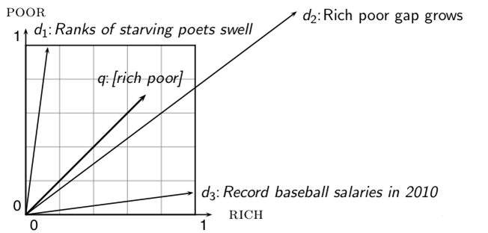
Why distance is a bad idea
The Euclidean distance of and is large although the distribution of terms in the query q
and the distribution of terms in the document d₂ are very similar.
Questions about basic vector space setup?
69

Slide 70
Use angle instead of distance
Rank documents according to angle with query
Thought experiment: take a document d and append it to itself. Call this document d′. d′ is twice as long as d.
“Semantically” d and d′ have the same content.
The angle between the two documents is 0, corresponding to maximal similarity . . .
. . . even though the Euclidean distance between the two documents can be quite large.
70

Slide 71
From angles to cosines
The following two notions are equivalent.
Rank documents according to the angle between query and document in decreasing order
Rank documents according to cosine(query,document) in increasing order
Cosine is a monotonically decreasing function of the angle for the interval [0◦, 180◦]
71

Slide 72
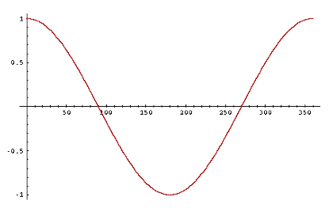
Cosine
72

Slide 73


Length normalization
How do we compute the cosine?
A vector can be (length-) normalized by dividing each of its components by its length – here we use the L₂ norm:
This maps vectors onto the unit sphere . . .
. . . since after normalization:
As a result, longer documents and shorter documents have weights of the same order of magnitude.
Effect on the two documents d and d′ (d appended to itself) from earlier slide: they have identical vectors after length-normalization.
73

Slide 74

Cosine similarity between query and document
q_{i} is the tf-idf weight of term i in the query.
d_{i} is the tf-idf weight of term i in the document.
This is the cosine similarity of and . . . . . . or, equivalently, the cosine of the angle between and
74

Slide 75

Cosine for normalized vectors
For normalized vectors, the cosine is equivalent to the dot product or scalar product.
(if and are length-normalized).
75

Slide 76
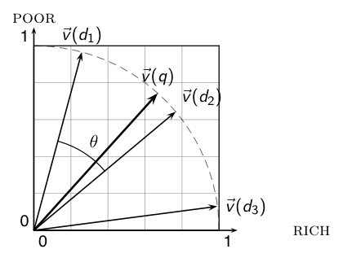
Cosine similarity illustrated
76

Slide 77
Cosine: Example
term frequencies (counts)
How similar are
these novels? SaS:
Sense and
Sensibility PaP:
Pride and
Prejudice WH:
Wuthering
Heights
term | SaS | PaP | WH
AFFECTION JEALOUS GOSSIP WUTHERING | 115 10 2 0 | 58 7 0 0 | 20 11 6 38
77

Slide 78
Cosine: Example
term frequencies (counts) log frequency weighting
(To simplify this example, we don't do idf weighting.)
term | SaS | PaP | WH
AFFECTION JEALOUS GOSSIP WUTHERING | 115 10 2 0 | 58 7 0 0 | 20 11 6 38
term | SaS | PaP | WH
AFFECTION JEALOUS GOSSIP WUTHERING | 3.06 2.0 1.30 0 | 2.76 1.85 0 0 | 2.30 2.04 1.78 2.58
78

Slide 79
Cosine: Example
log frequency weighting log frequency weighting &
cosine normalization
term | SaS | PaP | WH
AFFECTION JEALOUS GOSSIP WUTHERING | 3.06 2.0 1.30 0 | 2.76 1.85 0 0 | 2.30 2.04 1.78 2.58
term | SaS | PaP | WH
AFFECTION JEALOUS GOSSIP WUTHERING | 0.789 0.515 0.335 0.0 | 0.832 0.555 0.0 0.0 | 0.524 0.465 0.405 0.588
Normalization example:“AFFECTION“ – 3.06/sqrt(3.06^2+2^2+1.3^2)
cos(SaS,PaP) ≈ 0.789 ∗ 0.832 + 0.515 ∗ 0.555 + 0.335 ∗ 0.0 + 0.0 ∗ 0.0 ≈ 0.94.
cos(SaS,WH) ≈ 0.79
cos(PaP,WH) ≈ 0.69
Why do we have cos(SaS,PaP) > cos(SAS,WH)?
79

Slide 80
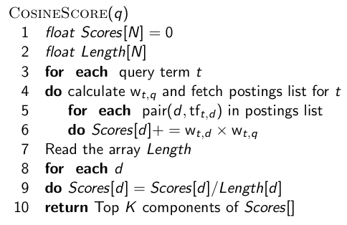
Computing the cosine score
80

Slide 81
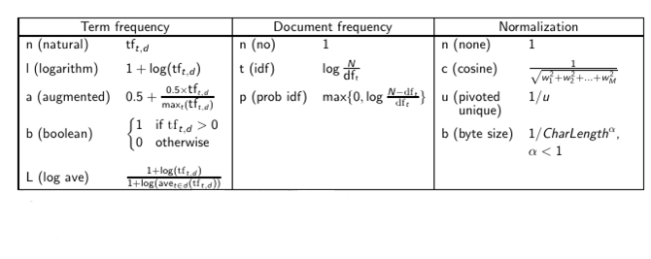
Components of tf-idf weighting
81

Slide 82
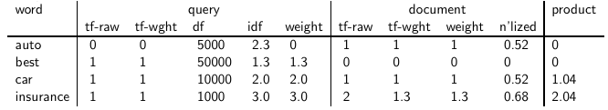
tf-idf example:
Query: “best car insurance”. Document: “car insurance auto insurance”.
Key to columns: tf-raw: raw (unweighted) term frequency, tf-wght: logarithmically weighted term frequency, df: document frequency, idf: inverse document frequency, weight: the final weight of the term in the query or document, n’lized: document weights after cosine normalization, product: the product of final query weight and final document weight
1/1.92 ≈ 0.52
1.3/1.92 ≈ 0.68 Final similarity score between query and
document: _{i} w_{qi} · w_{di} = 0 + 0 + 1.04 + 2.04 = 3.08
82

Slide 83
Summary: Ranked retrieval in the vector space model
Represent the query as a weighted tf-idf vector
Represent each document as a weighted tf-idf vector
Compute the cosine similarity between the query vector and each document vector
Rank documents with respect to the query
Return the top K (e.g., K = 10) to the user
83

Slide 84
Take-away today
Ranking search results: why it is important (as opposed to just presenting a set of unordered Boolean results)
Term frequency: This is a key ingredient for ranking.
Tf-idf ranking: best known traditional ranking scheme
Vector space model: One of the most important formal models for information retrieval (along with Boolean and probabilistic models)
84

